Slide 1

An Approach for Background Subtraction in Moving Object Detection And Tracking
Sajjad Ansari
M. Tech (Multimedia Information Processing)
Under the guidance of
Dr. S. K. DasMandal
Asst. Prof. (Center for Educational Technology)
IIT Kharagpur
Cet.iitkgp.ac.in

Slide 2
Introduction
Moving object detection and tracking in video streams are important operations in the field of computer vision.
There is a variety of object detection and tracking algorithms available, among which Background Subtraction method is the most popular one.
This presentation discusses the developed approach for background subtraction using non linear mean filters.
Along with the development of a better approach this presentation also reports the comparison of results obtained and previous study.

Slide 3
Problem
Mean Filter
Median Filter
Edge Preservation
Noise Removal
Edge Preservation
Noise Removal

Slide 4
Problem
Non-linear Mean Filter
Simple algorithms are less accurate.
Accurate algorithms are too much complex.
A few algorithms are real time.
Edge Preservation
Noise Removal

Slide 5
Methodology
Binarization
Noise Removal
Frame
Difference
BLOB
Analysis
Input Video
Moving Object

Slide 6
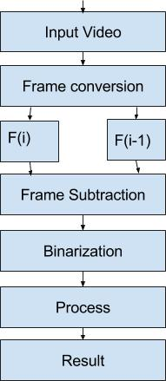
Frame Difference Background Subtraction

Slide 7
Table 1. Temporal differencing Technique
1 | Read current and previous frame
2 | Subtract the two frames
3 | Convert RGB to Gray
4 | Binarize the image
6 | Apply Median filter to remove noise

Slide 8
Table 2. Modified Temporal differencing Technique
1 | Read current and previous frame
2 | Subtract the two frames
3 | Convert RGB to Gray
4 | Binarize the image
6 | Apply Median filter to remove noise
7 | Apply Contra-harmonic Mean filter to eliminate noisy regions

Slide 9
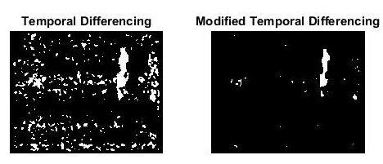
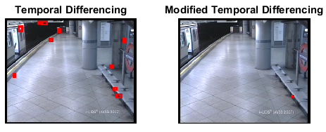
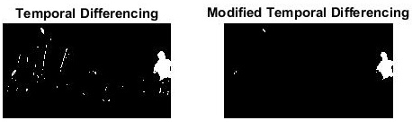
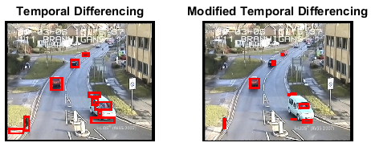
Findings

Slide 10
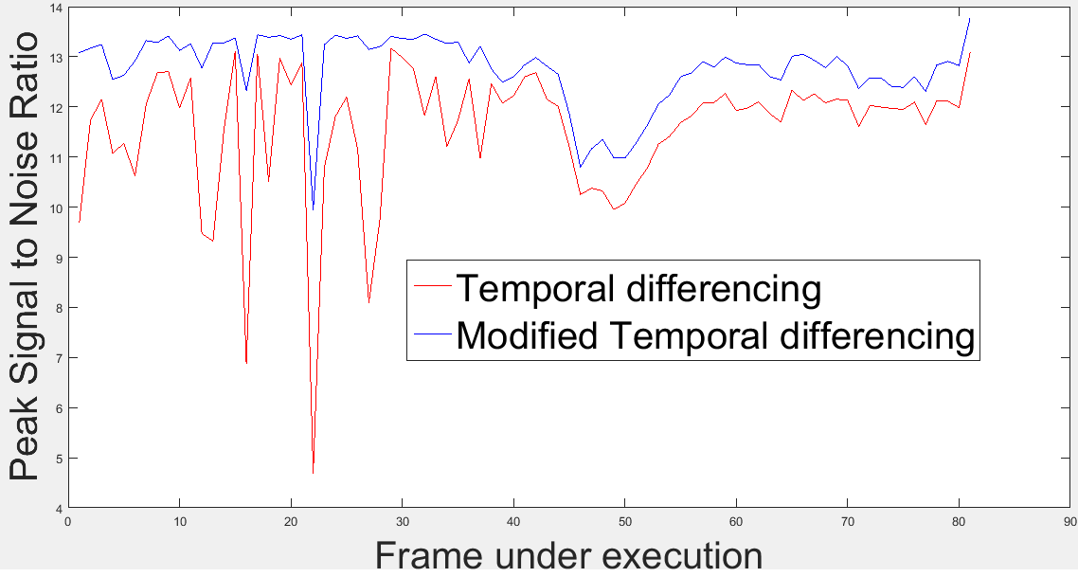
Experimental Results

Slide 11
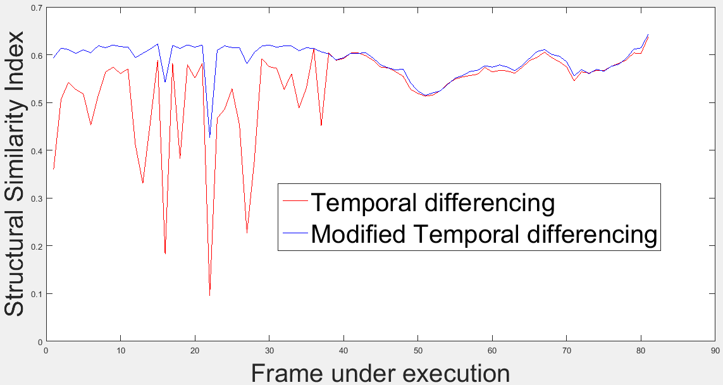
Experimental Results

Slide 12
Experimental Results
Table 3. Confusion Matrix for CCTV data (Temporal Differencing)
Total frames=5000 | Predicted: No motion | Predicted: Motion
Actual: No motion | 640(TN) | 360(FP)
Actual: Motion | 1146(FN) | 2854(TP)
Table 4. Confusion Matrix for CCTV data (Modified Temporal Differencing)
Total frames=5000 | Predicted: No motion | Predicted: Motion
Actual: No motion | 975(TN) | 25(FP)
Actual: Motion | 130(FN) | 3870(TP)

Slide 13
Experimental Results
Table 5. Confusion Matrix for Benchmark data (Temporal Differencing)
Total frames=1220 | Predicted: No motion | Predicted: Motion
Actual: No motion | 224(TN) | 493(FP)
Actual: Motion | 19(FN) | 484(TP)
Table 6. Confusion Matrix for Benchmark data (Modified Temporal Differencing)
Total frames=1220 | Predicted: No motion | Predicted: Motion
Actual: No motion | 422(TN) | 295(FP)
Actual: Motion | 10(FN) | 493(TP)

Slide 14
Calculations
Table 7. Calculated results on CCTV data
Parameter | Values
 | Developed approach | Previous approach
Sensitivity (Sn) | 0.9675 | 0.7135
Precision | 0.994 | 0.8882
Accuracy | 0.975 | 0.64
Specificity (Sp) | 0.025 | 0.36
Fall out (FPR) | 0.969 | 0.6988
F1 Score | 0.98 | 0.7913

Slide 15
Calculations
Table 8. Calculated results on Benchmark data
Parameter | Values
 | Developed approach | Previous approach
Sensitivity (Sn) | 0.98 | 0.962
Precision | 0.626 | 0.495
Accuracy | 0.5886 | 0.3124
Specificity (Sp) | 0.4114 | 0.6876
Fall out (FPR) | 0.75 | 0.5803
F1 Score | 0.764 | 0.6537

Slide 16
Conclusion
The performance of the developed approach for background subtraction is robust.
The results and calculations shows the effectiveness of the developed approach over the available one.
The developed approach is computationally cheaper.

Slide 17
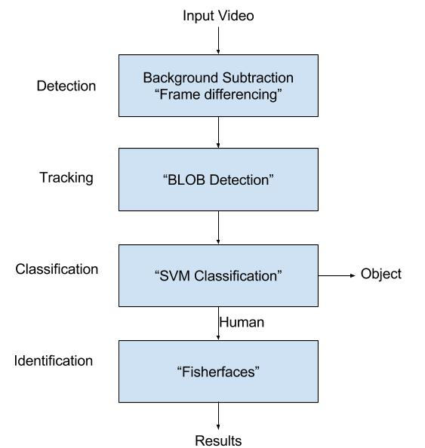
Scope of Future Work

Slide 18
Thank You
Queries?

